Slide 1


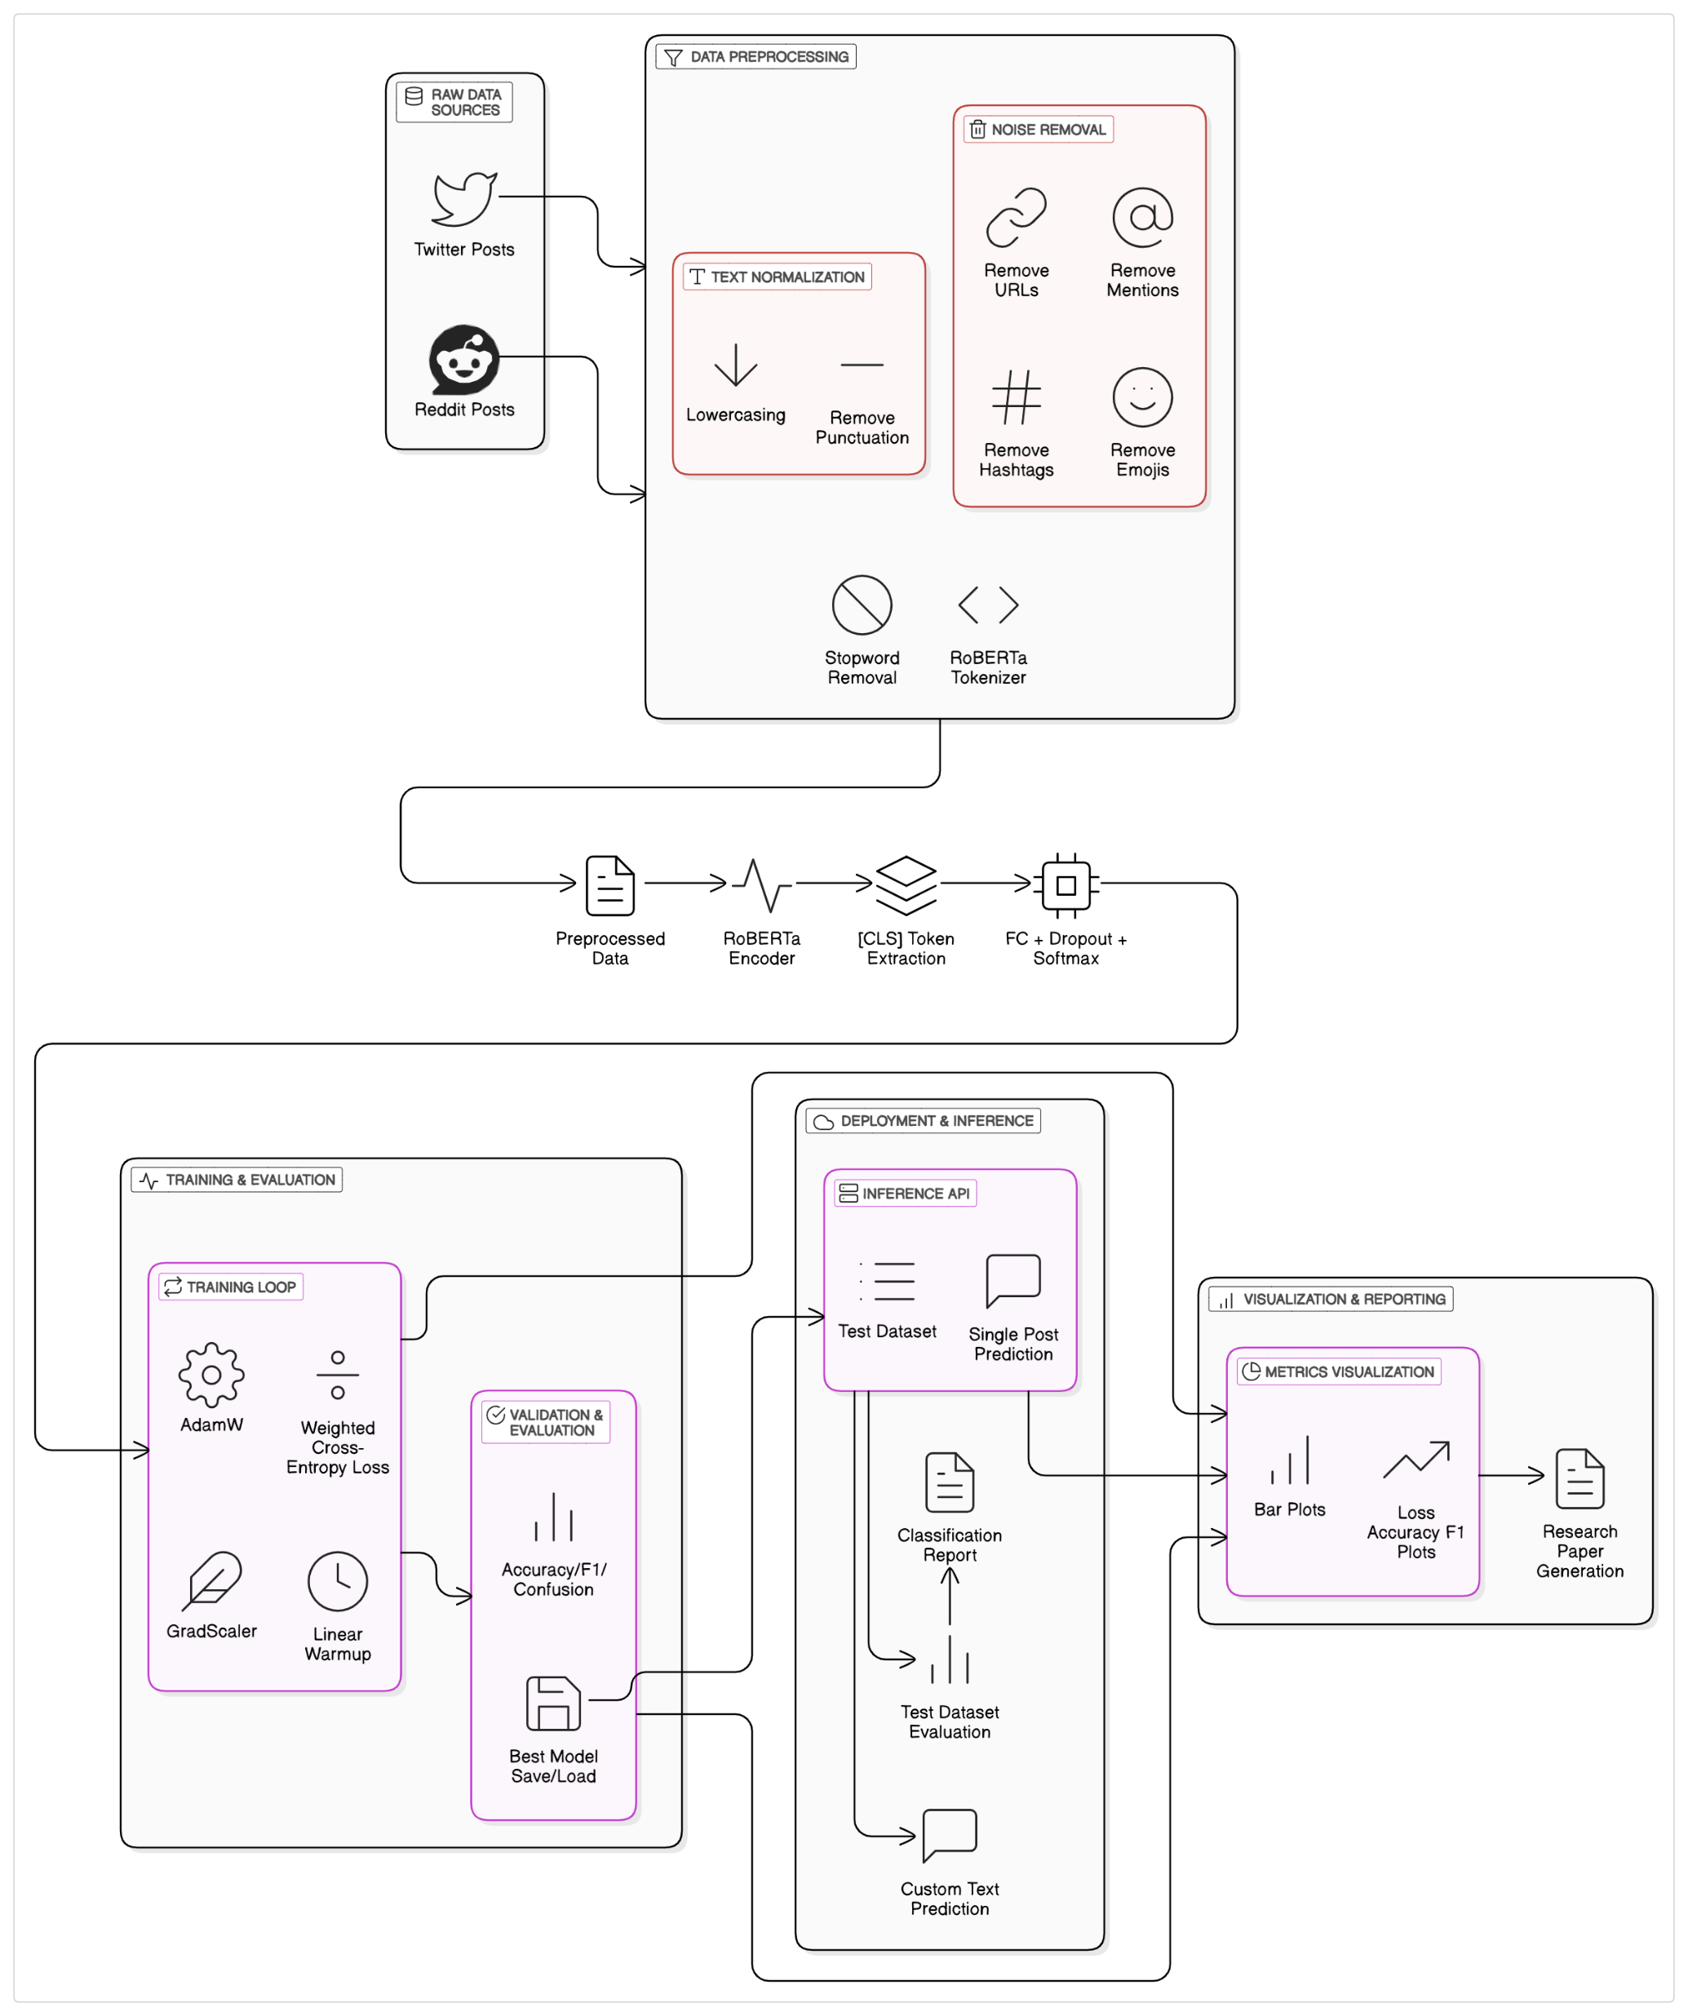
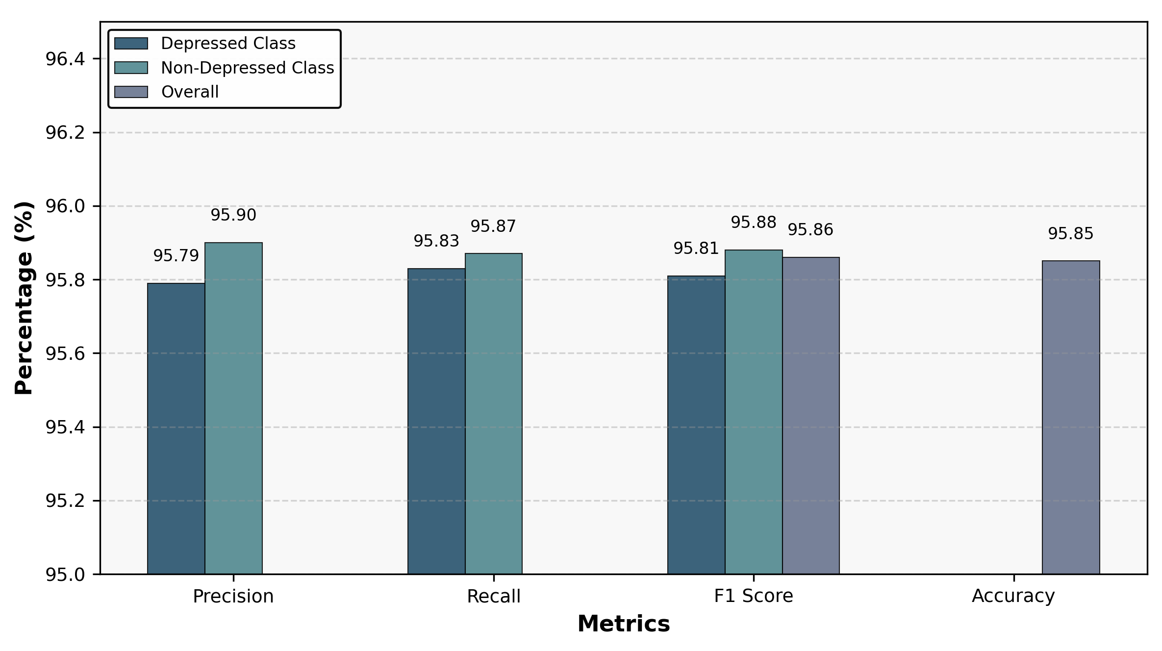
AI-Based Depression Detection from Social Media
Student Name: Muhammad Hassaan Shahid Registration No.: 2023-CS-79
Supervisor Name: Muhammad Waseem
Department of Computer Science, University of Engineering & Technology, Lahore
Abstract
Related Work
This study introduces an AI-driven system to detect depression from social media posts on platforms like Twitter and Reddit, leveraging RoBERTa, a transformer model. A dataset of 10,000 posts (60% non-depressed, 40% depressed) was preprocessed to remove noise (URLs, hashtags, emojis) and tokenized. Fine-tuned on an NVIDIA V100 with class weighting, the model achieves 95.85% accuracy and 95.86% F1 score, outperforming benchmarks like prior work. By capturing linguistic cues such as negative sentiment and self-referential language, this system lays the foundation for scalable tools to flag mental health risks in real time, offering hope for early intervention and support for those silently struggling with depression.
The field of AI-based depression detection is rich with diverse approaches. Wang et al. (2013) used Bayesian classifiers on Sina microblogs, achieving an F-measure of 0.812. Fatima et al. (2018) reached 95.0% accuracy on LiveJournal with Random Forest, focusing on linguistic cues. Orabi et al. (2018) combined CNN and RNN for 88.0% accuracy on Twitter. Gupta et al. (2023) applied DistilBERT to Reddit, scoring an F-measure of 0.82. Park et al. (2024) used XGBoost on TikTok, hitting 76.0% accuracy, while Chen et al. (2024) leveraged graph neural networks on LinkedIn for an F-measure of 0.80. This work builds on these, using RoBERTa to achieve 95.85% accuracy.
Introduction
Sr No. | Year | Model | Datasets | Acc/F1 | Description
1 | 2013 | Bayes, Trees | Sina microblog (468 posts) | 0.812 | User interactions, post content
2 | 2018 | RF, SVM | LiveJournal (4026 posts) | 95.0% | Linguistic cues like pronouns
3 | 2018 | CNN, RNN, SVM | Twitter (154 subjects) | 88.0% | Short, informal text
4 | 2023 | DistilBERT | Reddit (600 users) | 0.82 | Lightweight, scalable model
5 | 2024 | XGBoost | TikTok (1000 comments) | 76.0% | Short, dynamic text
6 | 2024 | GNN, NLP | LinkedIn (300 posts) | 0.80 | Professional network data
7 | 2025 | RoBERTa | Twitter/Reddit (10,000 posts) | 95.85% | Text cleaning, class weighting
Background
Global Challenge: Depression impacts over 280 million people worldwide, making it a leading cause of disability and emotional distress (prior work).
Social Media Insights: Platforms like Twitter and Reddit serve as windows into users’ minds, capturing raw emotions—despair, hopelessness, or occasional hope—in real-time posts.
Digital Traces: These posts reveal linguistic patterns, such as negative sentiment or frequent use of “I,” which are known indicators of depressive states.
Opportunity for AI: The volume and authenticity of social media data offer a unique chance to detect depression early, enabling timely support for those in need.
Motivation
Need for Early Action: Depression is treatable with therapy or support, but late detection can lead to severe outcomes, impacting lives and communities.
Detection Challenges: Identifying at-risk individuals is difficult due to stigma, limited access to care, and reliance on self-reported symptoms.
Social Media’s Role: Users share unfiltered thoughts online, providing a non-invasive source for monitoring mental health signals.
AI’s Potential: Advanced AI can analyze millions of posts to flag depressive patterns, enabling early intervention and guiding people to resources.
Significance
High Performance: Achieves 95.85% accuracy, outperforming prior studies and setting a new benchmark for depression detection.
Technical Innovation: Leverages RoBERTa’s deep language understanding and robust preprocessing to handle noisy, imbalanced social media data.
Real-World Impact: Lays the foundation for scalable tools that could integrate with platforms like Twitter or Reddit to flag mental health risks in real time.
Broader Vision: Advances AI-driven mental health support, offering hope for early intervention and improved outcomes for millions.
Results
The RoBERTa model achieved 95.85% accuracy and 95.86% F1 score on a 1,000-post test set, outperforming prior work.
Depressed Class: Precision 95.79%, Recall 95.83%, F1 95.81%.
Non-Depressed Class: Precision 95.90%, Recall 95.87%, F1 95.88%.
Overall: Accuracy 95.85%, F1 95.86%.
Qualitative Insights: Correctly identified posts like “I’m so tired of everything” (Depressed, 0.92) but struggled with sarcasm (e.g., “Wow, I’m thriving”).
Comparison: Surpasses prior work’s 88.0% and 71.2% accuracies.
Table: Performance Metrics
Figure: Bar Plot (precision, recall, F1 score for classes; overall accuracy, F1).
Methodology
Conclusion & Future Directions
Conclusion:
The RoBERTa-based system detects depression with 95.85% accuracy, surpassing prior benchmarks through advanced NLP and robust preprocessing. It offers a foundation for real-time mental health tools, potentially saving lives by flagging risks early.
Future Directions:
Integrate multimodal data (images, posting times) to boost accuracy.
Develop a real-time API for platforms like X, addressing scalability.
Expand dataset to include non-English posts and diverse cultures.
Improve sarcasm detection and ensure ethical use with anonymized data and user consent. This work underscores AI’s potential to bridge technology and empathy, inspiring tools that connect people to help.
References
H. Chen et al., “Graph neural networks for depression detection on linkedin,” in Proc. IEEE Conf., 2024
S. Park et al., “Xgboost-based depression detection from tiktok com-ments,” in Proc. IEEE Conf., 2024
R. Gupta et al., “Distilbert for scalable depression detection on reddit,”in Proc. IEEE Conf., 2023
M. Islam et al., “Depression detection from social media comments,” inProc. IEEE Conf., 2018
J. Kim et al., “Bert-based depression detection from instagram posts,” in Proc. IEEE Conf., 2021
S. Tsugawa et al., “Recognizing depression from twitter activity,” in Proc. CHI Conf., 2015
Y. Li et al., “Neural network-based depression detection,” in Proc. IEEE Conf., 2020
S. Burdisso et al., “A text classification framework for early depression detection,” in Proc. IEEE Conf., 2019

